Slide 1
Learning Microsoft Power Point 2007

Slide 2
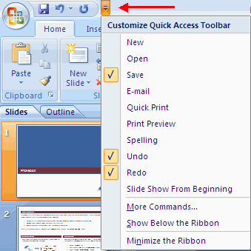
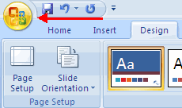
Getting Started
There are three features that you should remember as you work within PowerPoint 2007: the Microsoft Office Button, the Quick Access Toolbar, and the Ribbon, that are expended before in word 2007.

Slide 3
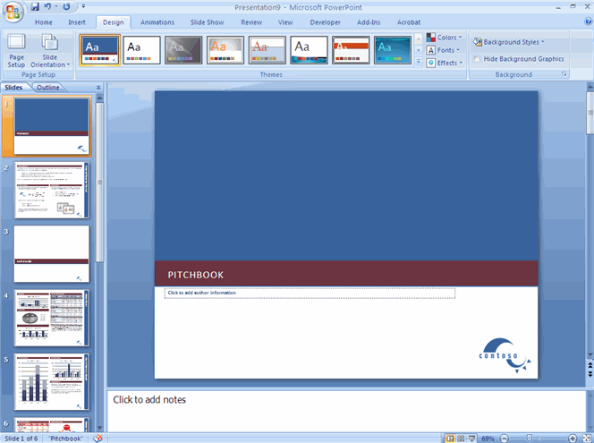
Getting Started
A Presentations : is a collection of data and information that is to be delivered to a specific audience . PowerPoint presentation is a collection of electronic slides that can have text, pictures, graphics, tables, sound and video . This collection can run automatically or can be controlled by a presenter.

Slide 4
Navigation
Navigation through the slides can be accomplished through
The Slide Navigation menu on the left side of the screen.
Also, an outline appears from materials that have been entered in the presentation.

Slide 5
Slide Views
Presentations can be viewed in a variety of manners. On the View tab, the Presentation Views group allows you to view the slides as Normal, Slide Sorter, Notes Page, Slide Show, Slide Master, Handout Master, and Notes Master.

Slide 6
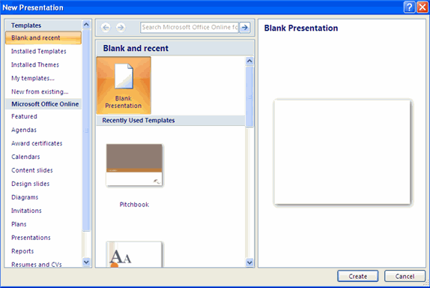
Create New Presentation
You can start a new presentation from a blank slide, a template, existing presentations, or a Word outline .
To create a new presentation from a blank slide:
Click the Microsoft Office Button.
Click New.
Click Blank and recent from Templates Tab .
Choose Blank Presentation .

Slide 7
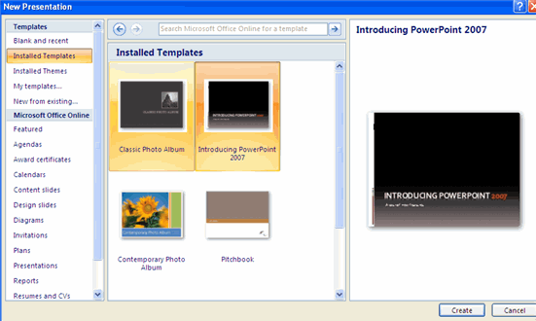
Create New Presentation
To create a new presentation from a template:
Click the Microsoft Office Button.
Click New.
Click Installed Templates or Browse through Microsoft Office Online Templates.
Click the template you choose.

Slide 8
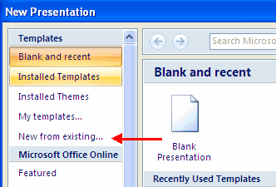
Create New Presentation
To create a new presentation from an existing presentation:
Click the Microsoft Office Button.
Click New.
Click New from Existing.
Browse to and click the presentation.

Slide 9
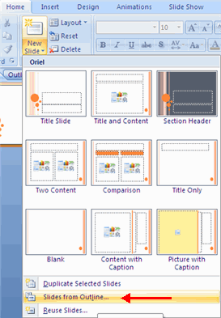
Create New Presentation
To create a new presentation from a Word outline:
Click the slide where you would like the outline to begin.
Click New Slide on the Home tab.
Click Slides from Outline.
Browse and click the Word Document that contains the outline.

Slide 10
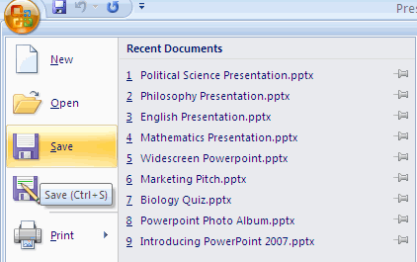
Save a Presentation
When you save a presentation, you have two choices: Save or Save As.
To save a document:
Click the Microsoft Office Button.
Click Save.

Slide 11
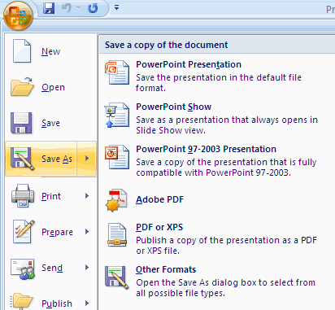
Save a Presentation
To use save As feature:
Click the Microsoft Office Button.
Click Save As.
Type in the name for the Presentation.
In the Save as Type box, choose type you want ( ex. PowerPoint 97-2003 Presentation).

Slide 12
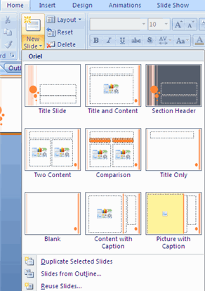
Add Slides
There are several choices when you want to add a new slide to the presentation: Office Themes, Duplicate Selected Slide, or Reuse Slides.
To create a new slide from Office Themes:
Select the slide immediately before where you want the new slide.
Click the New Slide button on the Home tab.
Click the slide choice that fits your material.

Slide 13
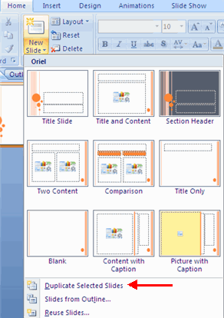
Add Slides
To create a new slide as a duplicate of a slide in the presentation:
Select the slide to duplicate.
Click the New Slide button on the Home tab.
Click Duplicate Selected slides .

Slide 14
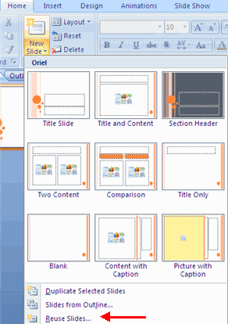
Add Slides
To create a new slide from another presentation:
Select the slide immediately before where you want the new slide.
Click the New Slide button on the Home tab.
Click Reuse Slides.
Click Browse .
Click Browse File.
Locate the slide show and click on the slide to import.

Slide 15
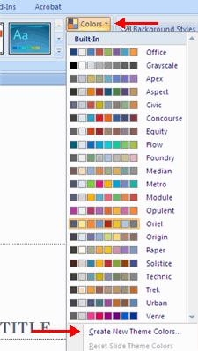
Themes
To add a theme to a presentation:
Click the Design tab.
Choose one of the displayed Themes or click the Galleries button.
To apply new colors to a theme:
Click the Colors drop down arrow.
Choose a color set or click Create New Theme Colors.

Slide 16
Themes
To change the background style of a theme:
Click the Background Styles button on the Design tab.
Select background from existing style and if you need change in color or format choose Format Background.

Slide 17
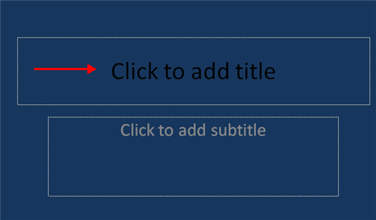
Enter Text
To enter text:
Select the slide where you want the text.
Click in a Textbox to add text.

Slide 18
Formatting Text
As you learn in word 2007

Slide 19
Adding Content Resize a Textbox
To resize a textbox:
Click on the textbox.
Click the corner of the box and drag the cursor to the desired size.

Slide 20
Adding Content Adding Video
Video clips can be added to the presentation. To add a video clip:
Click the Movie button on the Insert tab.
Choose Movie from File or Movie from Clip Organizer.

Slide 21
Adding Content Adding Audio
Audio clips can be added to the presentation. To add an audio clip:
Click the Audio button on the Insert tab.
Choose Sound from File, Sound from Clip Organizer, Play CD Audio Track, or Record Sound.

Slide 22
Graphics & Tables Was Taken in Word
Adding Picture.
Adding Clip Art.
Editing Pictures and Clip Art.
Adding a Shape.
Adding Smart Art.
Create a Table.
Enter Data in a Table.
Modify the Table Structure and Format a Table.
Insert a Table from Word or Excel.

Slide 23
Run Your PowerPoint Slide Show
After you create your slides, you can run your slide show by doing any one of the following:
Press F5.
Choose the Slide Show tab. Click the From Beginning button in the Start Slide Show group.
Click the Slide Show icon in the bottom-right corner of your screen.

Slide 24
Navigating the Slide Show
Navigating the Slide Show
Procedure | Task
Do one of the following: Press the Right Arrow key. Press the Page Down key. Press the Enter key. | Go to the next slide.
Do one of the following: Press the Left Arrow key. Press the Page Up key. Press the Backspace key. | Go to the previous slide.
Press the Esc key. | End the slide show and return to PowerPoint.

Slide 25
Charts

Slide 26
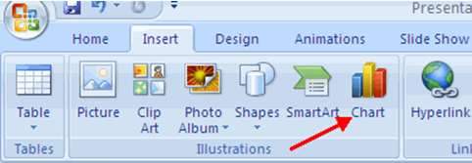
Charts
Charts allow you to present information contained in the worksheet in a graphic format. PowerPoint offers many types of charts including: Column, Line, Pie, Bar, Area, Scatter and more. To view the charts available click the Insert Tab on the Ribbon.

Slide 27
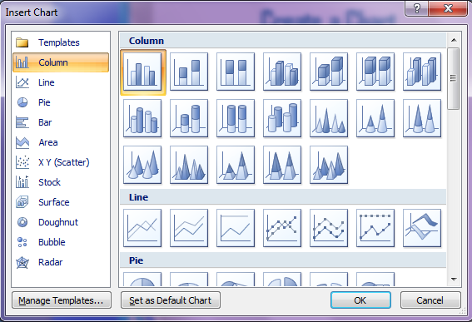
Create a Chart
Click the Insert tab on the ribbon.
Click the type of Chart you want to create.
Insert the Data and Labels.

Slide 28
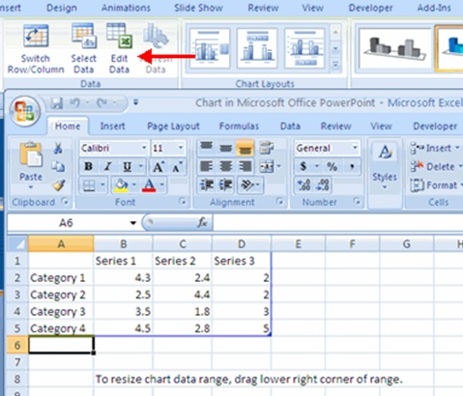
Edit Chart Data
Click on the chart.
Click Edit Data on the Design tab.
Edit data in the spreadsheet.

Slide 29
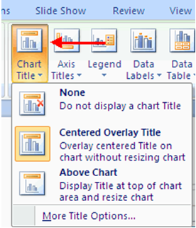
Modify the labels and titles
Click the chart
Click the Layout tab
Choose the appropriate label to change

Slide 30
Slide Effects

Slide 31
Slide Transitions
Transitions are effects that are in place when you switch from one slide to the next. To add slide transitions:
Select the slide that you want to transition .
Click the Animations tab .
Choose the appropriate animation or click the Transition dialog box.
Click the Apply to All button to apply transition to all slides.

Slide 32
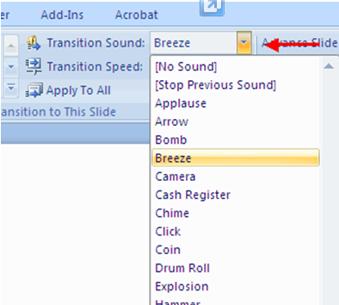
Adjust slide transitions
Add sound by clicking the arrow next to Transition Sound .

Slide 33
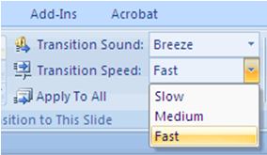
Adjust slide Transitions
Modify the transition speed by clicking the arrow next to Transition Speed .

Slide 34
Slide Animation
Slide animation effects are predefined special effects that you can add to objects on a slide. To apply an animation effect:
Select the object.
Click the Animations tab on the Ribbon.
Click Custom Animation.
Click Add Effect.
Choose the appropriate effect.

Slide 35
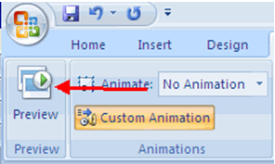
Animation Preview
To preview the animation on a slide:
Click the Preview button on the Animations tab

Slide 36
Automate all of the slides in PowerPoint 2007
Check the On Mouse Click check box.
Click the Automatically After check box.
Type 00:07 in the Automatically After text box.
Click the Apply to All button . PowerPoint applies all of your changes to all of the slides.

Slide 37
Rearranging Slides

Slide 38
Dragging and Dropping :Dragging and Dropping
Dragging and dropping selected slides is an easy way to move slides anywhere in your presentation.
From the View tab, in the Presentation Views group, click SLIDE SORTER
OR In the lower right corner of the window, click SLIDE SORTER .

Slide 39
Dragging and Dropping :Dragging and Dropping
Select the slide(s) you want to move.
Click and hold the selected slide(s).
Drag the slide(s) into the appropriate position A line appears between the slides indicating the placement of the selected slide(s).
Release the mouse button. The slide(s) appear in a new location

Slide 40
Rearranging Slides: Cut and Paste
From the View tab, in the Presentation Views group, click SLIDE SORTER
From the Home tab, in the Clipboard group, click CUT OR Right click the slide(s) » select Cut
Click in the space where you want the slide(s) inserted A line appears between the slides indicating the placement of the selected slide(s).
From the Home tab, in the Clipboard group, click PASTE OR Right click the location » select Paste

Slide 41
Hiding Slides
When giving your presentation, you may decide to not present certain slides, but you do not want them deleted. PowerPoint allows you to hide selected slides so they will not appear during the slide show. Hiding your slides will not delete them, so if you decide to include the hidden slide, you can easily show it.
From the View tab, in the Presentation Views group, click SLIDE SORTER
Select the slide(s) you wish to hide

Slide 42
Hiding Slides (Conts)
From the Slide Show tab, in the Set Up group, click HIDE SLIDE
To show slide click HIDE SLIDE.

Slide 43
References
http://www.fgcu.edu/support/office2007/ppt/index.asp
http://www.uwec.edu/help/ppoint07/sorter.htm

